Slide 1



Agentic AI
Agentic Framework
Prototype Blueprint
AI Labs- Micro CoE

Slide 2

AUtoGEn

Slide 3
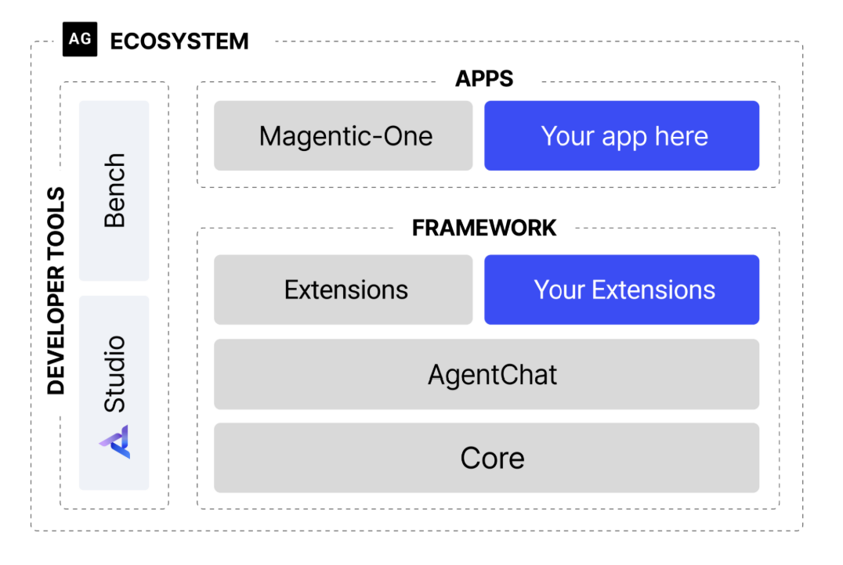
Background
AutoGen framework Primitives
AutoGen is an open-source programming framework for building AI agents and facilitating cooperation among multiple agents to solve tasks.
Emerged in March 2023, by late 2023, it was among GitHub’s most trending projects, highlighted by Microsoft leadership, and featured on open-source awards lists.
Latest stable release: AutoGen v0.4, launched on January 14, 2025
If you're building multi-agent workflows, AutoGen provides everything from low-level primitives to high-level tooling, making it a compelling choice in the agentic AI space, alongside frameworks like OpenAI Agents SDK, Google ADK, and Lang Graph.
Key Feature:
Supports dynamic group chats, tool integration, and human-in-the-loop workflows.
Integrates with LLMs (e.g., OpenAI, Azure) and external tools via autogen_ext.
ConversableAgent: Creates agents that can communicate, process messages, and execute tasks in multi-agent systems.
GroupChat: Facilitates conversations among multiple agents, managing message flow and interactions.
GroupChatManager: Coordinates group conversations, ensuring proper agent selection and message routing.
register_for_execution: Enables agents to register and execute custom tool functions for task automation.
llm_config: Configures language model settings for agents, integrating with various LLM providers.
is_termination_msg: Specifies conditions to end a conversation, allowing flexible termination logic.
speaker_selection_method: Defines custom logic to select the next agent to respond in a group chat.
autogen_ext: Extends AutoGen with additional integrations, such as support for external LLM APIs like Azure OpenAI.
Documentation
Architecture
AutoGen Documentation
AutoGen GitHub Repo
AutoGen studio
Library import
from autogen import ConversableAgent, GroupChat, GroupChatManager

Slide 4
Framework Evaluation
When to use: Mostly for prototyping or Research
Agent Conversation Style
You want to include human input, like in customer support systems, where a person can step in.
You need to prototype using tools like APIs or databases, such as in coding assistants or data analysis.
You’re building scalable systems on AZURE that can run on different machines or across organizations.
Limitations: Not fully ready for PROD
It can be hard to handle multiple agents, especially with dynamic workflows. Even though newer versions (like v0.4) have improved this with better tools, it still takes effort to design and debug these systems.
When agents work on their own, their actions can be hard to predict, requiring advanced skills to manage. This can make development slower and more complex..
Agent types possible in
Orchestrator Agent: Coordinates tasks and communication among multiple agents to achieve a unified goal.
Tool-Executing Agent: Executes specific functions or tools, such as API calls or computations, to perform tasks.
Conversational Agent: Engages in dialogue with users or other agents, processing and responding to messages.
Proxy Agent: Acts as an intermediary, relaying messages or executing tasks on behalf of users or other agents.
Specialized Task Agent: Handles domain-specific tasks, like data analysis, code generation, or content creation.
Human-in-the-Loop Agent: Incorporates human input for decision-making or validation during task execution.
Stateful Agent: Maintains context or state across interactions to support complex, multi-step workflows.
Autonomous Agent: Operates independently with predefined logic, making decisions without external input.

Slide 5


Framework-in Action
Weather app
Low–level System Design
Tech Stack

Slide 6
OPEN ai- Agent SDK

Slide 7
Background
AutoGen framework Primitives
Documentation

Slide 8
Framework Evaluation
Benefits
High Level Design
Limitations

Slide 9
Framework-in Action
Weather app
Low–level System Design
Tech Stack

Slide 10

CREW AI

Slide 11
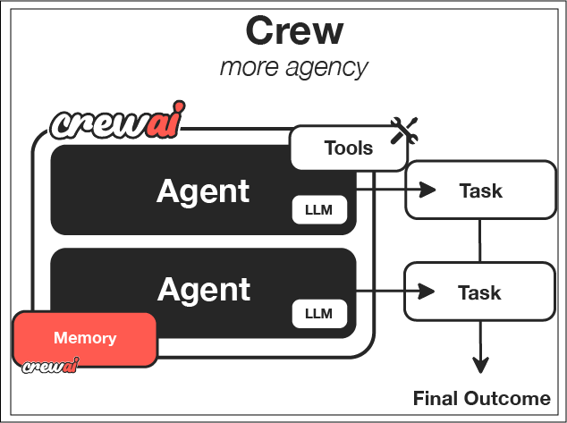
Background
CrewAI Framework Primitives
Documentation
Overview
CrewAI Documentation
CrewAI GitHub Repo
CrewAi studio

Slide 12
Framework Evaluation
Benefits
High Level Design
Limitations

Slide 13
Framework-in Action
Weather app
Low–level System Design
Tech Stack

Slide 14
Google – ADK

Slide 15
Background
AutoGen framework Primitives
Documentation

Slide 16
Framework Evaluation
Benefits
High Level Design
Limitations

Slide 17
Framework-in Action
Weather app
Low–level System Design
Tech Stack

Slide 18
Langgraph

Slide 19
Background
AutoGen framework Primitives
Documentation

Slide 20
Framework Evaluation
Benefits
High Level Design
Limitations

Slide 21
Framework-in Action
Weather app
Low–level System Design
Tech Stack

Slide 22
phiData

Slide 23
Background
AutoGen framework Primitives
Documentation

Slide 24
Framework Evaluation
Benefits
High Level Design
Limitations

Slide 25
Framework-in Action
Weather app
Low–level System Design
Tech Stack

Slide 26
About Us
Stands out in market
Innovative features
Provides unique solution
Edge over competitors
User-focused design
Prioritizes user experience

Slide 27
Product overview
Combining functionality and user-friendliness, we empower users to streamline operations and boost efficiency

Slide 28
Market comparison
Stands out in market
Innovative features
Provides unique solution
Edge over competitors
User-focused design
Prioritizes user experience

Slide 29
Growth Strategy
Expand market reach through strategic partnerships
Enhance product features based on user feedback
Explore international market opportunities
Expand
Foster collaborative growth
Enhance
Ensure a tailored and user-focused experience
Explore
Capitalize on emerging global markets

Slide 30
FINANCIALS
Quarter | Revenue ($) | Expenses ($) | Net profit ($)
Q1 | $200,000 | $150,000 | $50,000
Q2 | $300,000 | $200,000 | $100,000
Q3 | $400,000 | $250,000 | $150,000
Q4 | $300,000 | $200,000 | $100,000

